Slide 1



Slide 2


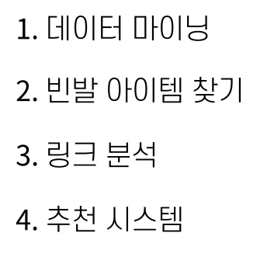

Slide 3
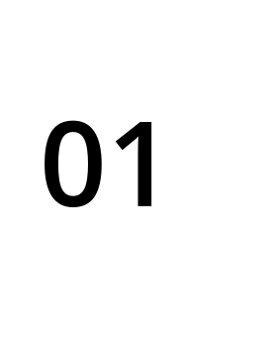


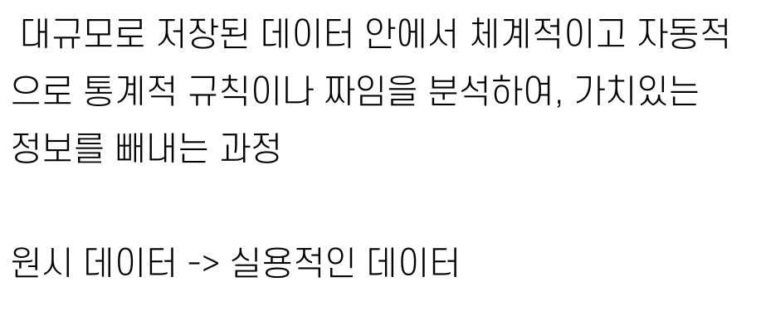

Slide 4



Slide 5
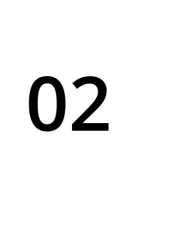

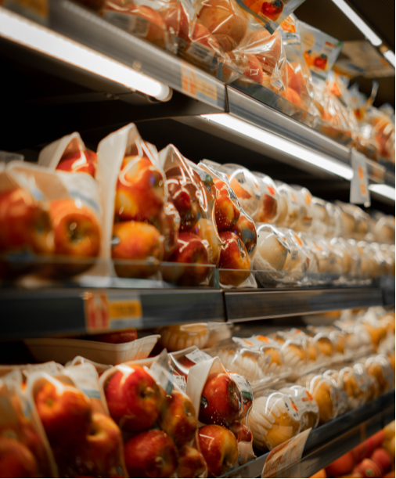


Slide 6
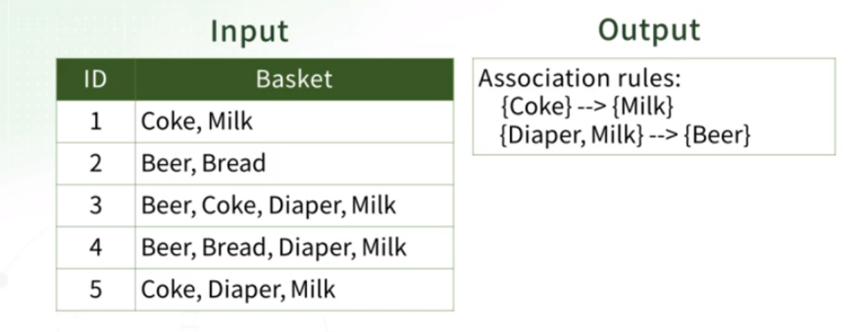

Slide 7

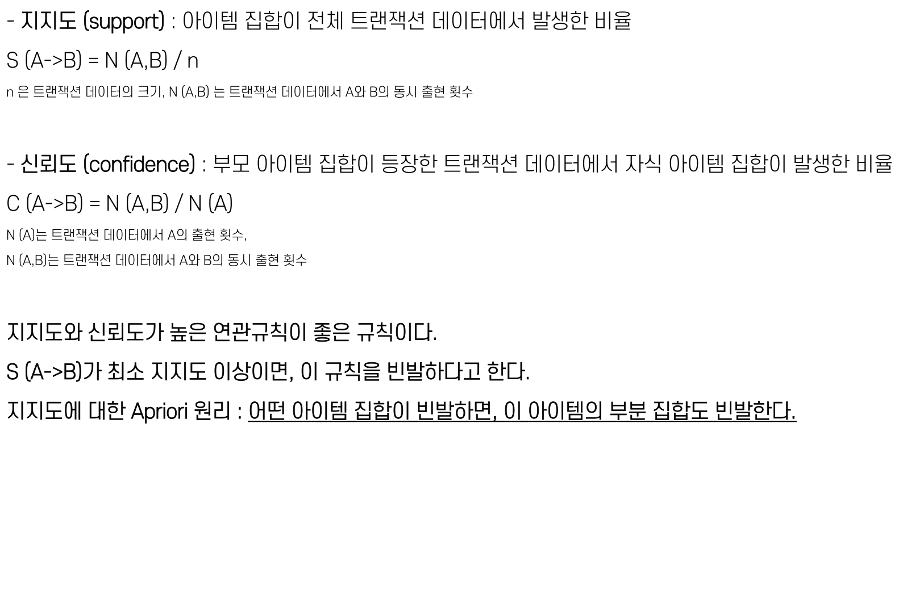

Slide 8




Slide 9
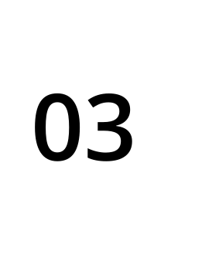


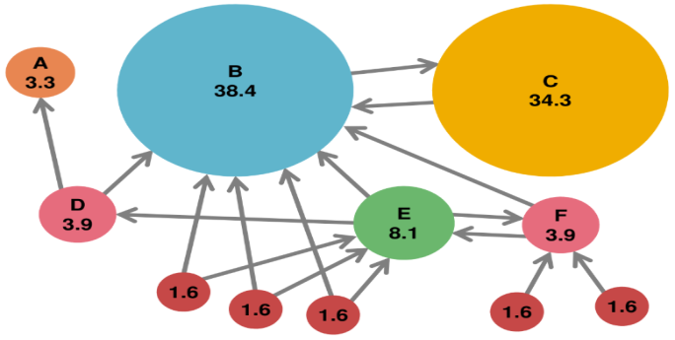

Slide 10
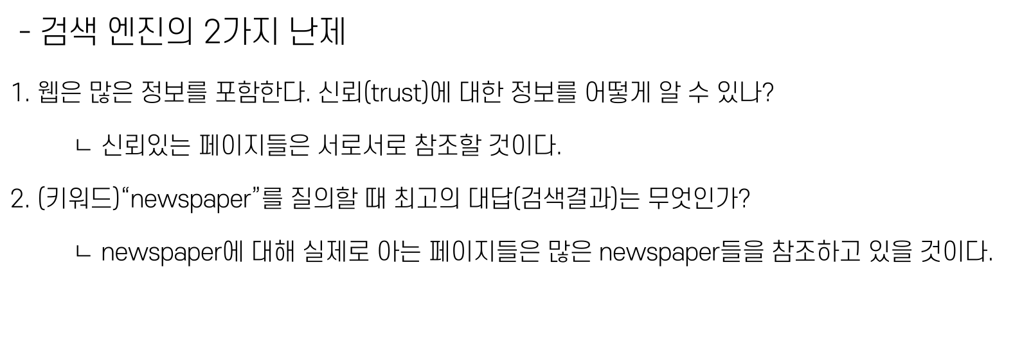

Slide 11


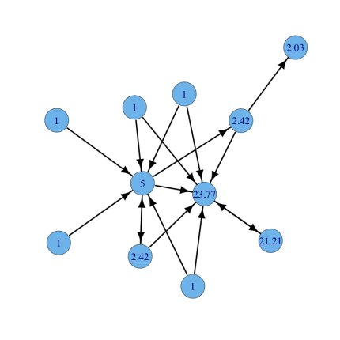


Slide 12




Slide 13
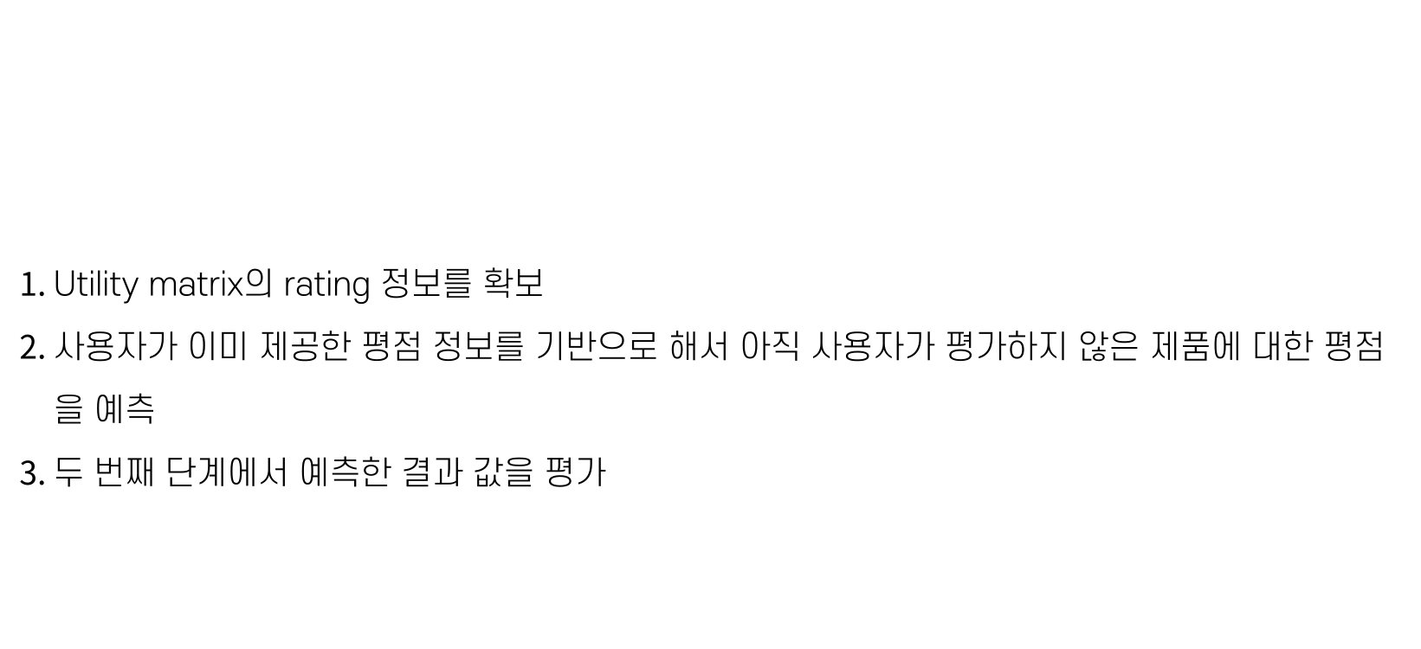

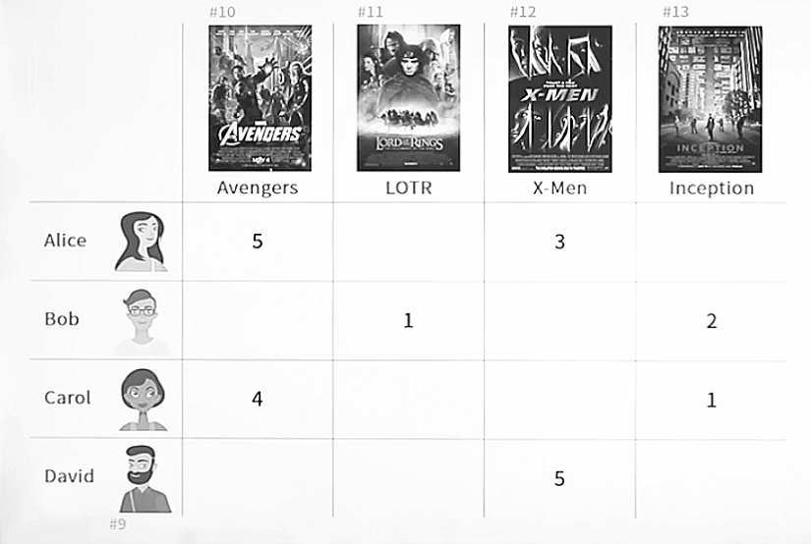


Slide 14

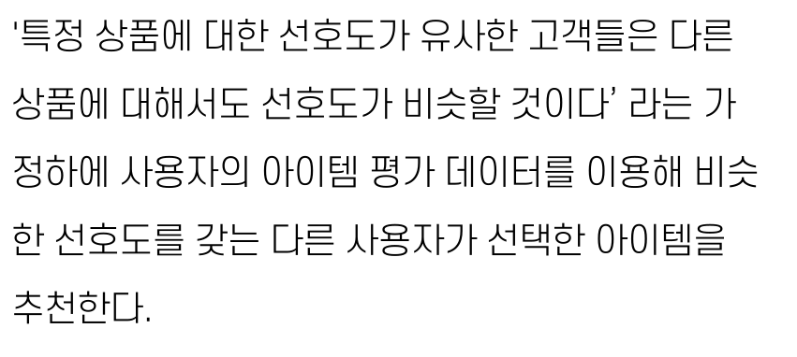

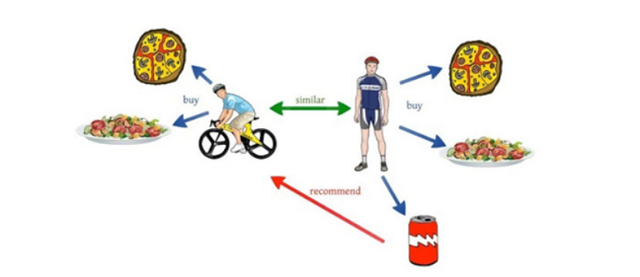

Slide 15
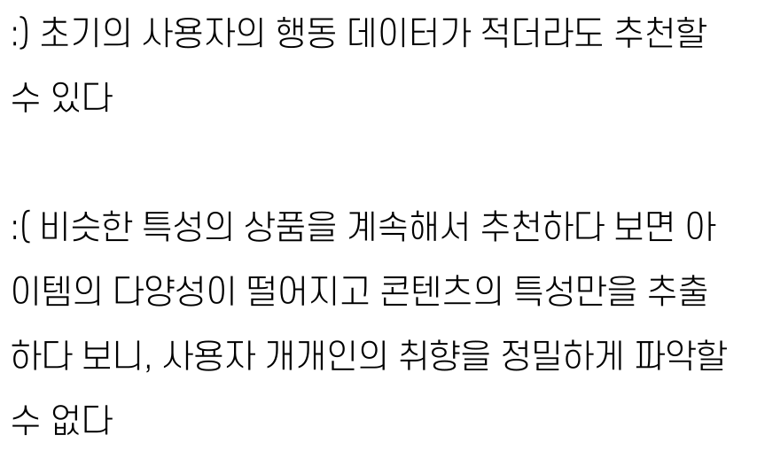
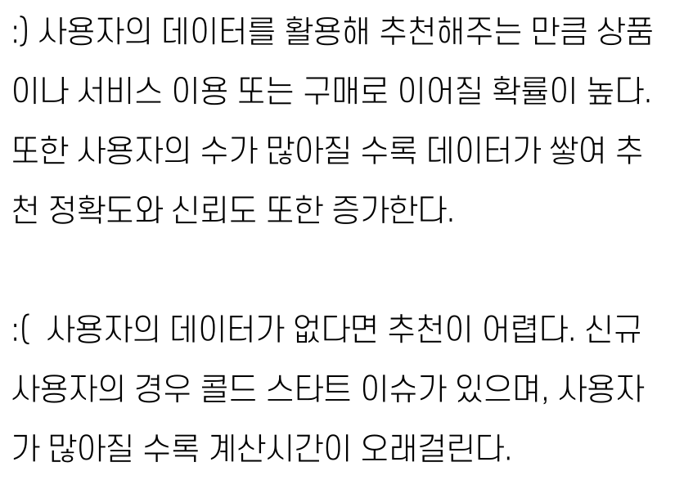

Slide 16

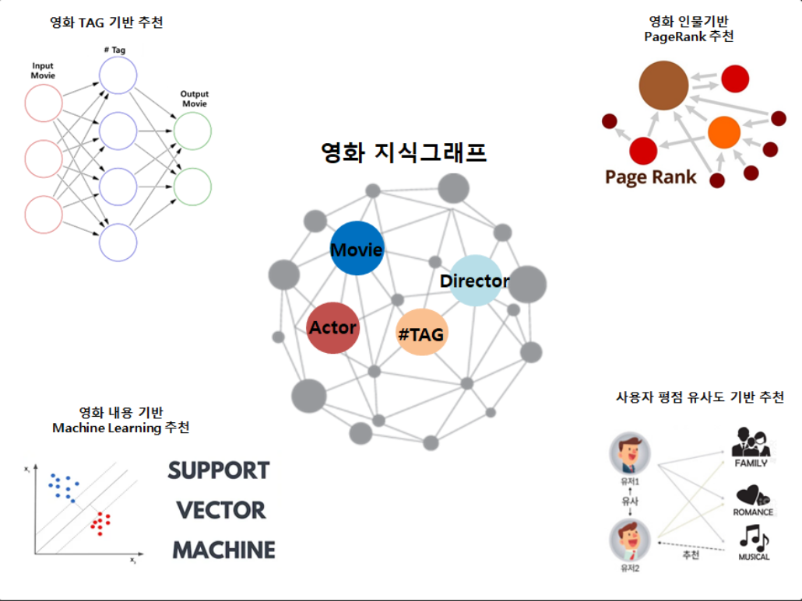
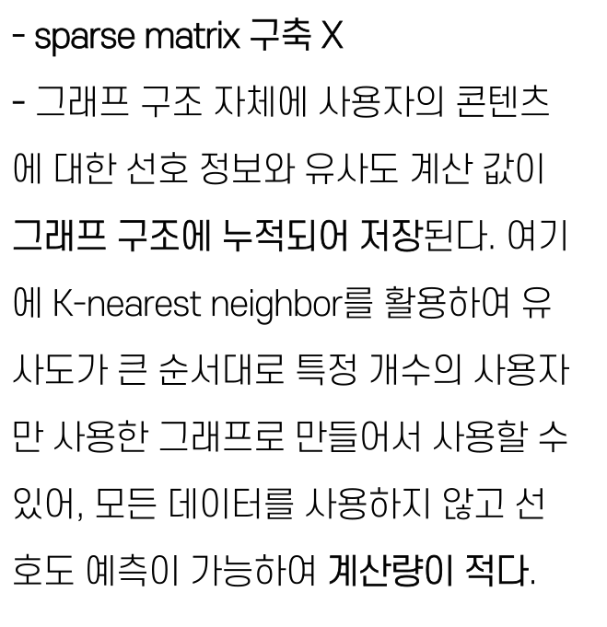

Slide 17
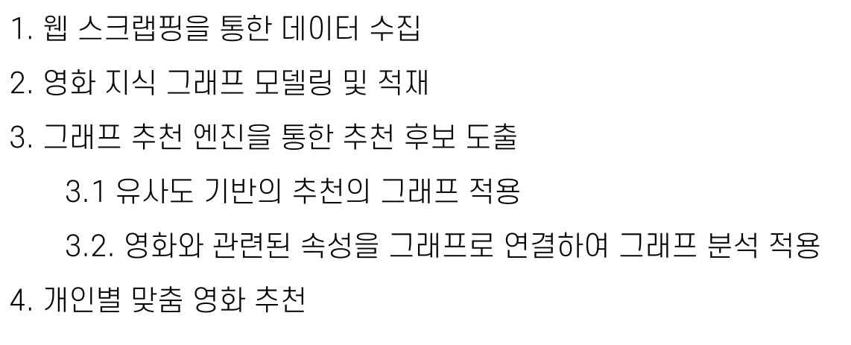
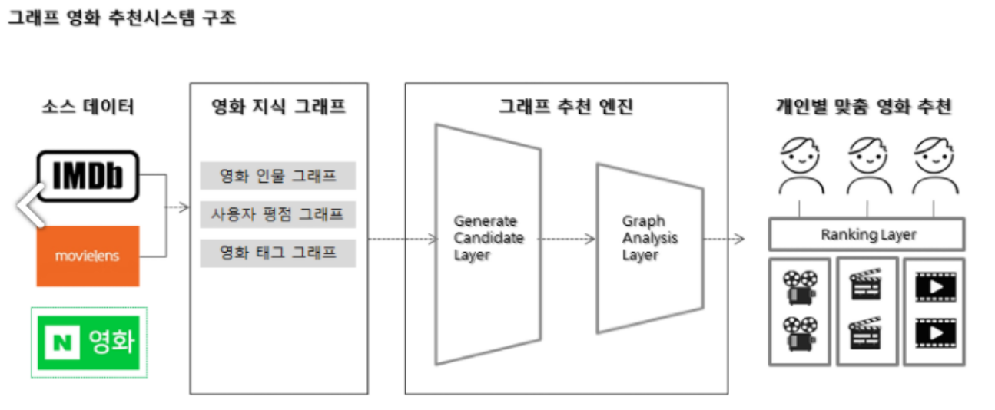

Slide 18



Slide 19
강의 http://www.kmooc.kr/courses/course-v1:SNUk+SNU049_011k+2023_T1/video
참고 https://velog.io/@jangfall_2115/Chapter-12.-%EC%96%B4%EB%94%94%EC%84%9C-%EB%A7%8E%EC%9D%B4-%EB%B4%A4%EB%8D%98-%ED%8C%A8%ED%84%B4%EC%9D%B4%EB%8B%A4-%EC%8B%B6%EC%9D%84-%EB%95%8C-%EB%B9%88%EB%B0%9C-%ED%8C%A8%ED%84%B4-%ED%83%90%EC%83%89-1
https://movefast.tistory.com/242
https://bitnine.tistory.com/508

Slide 20


